Slide 1



A social media App for Bloggers
A Web-application by Angular

Slide 2

WHO WE ARE
Sayan Chowdhury
Sankha Mondal
Sunil Maity
Promise Dutta
Pralay Ghosh
Department-CSE
Guided By Nirupam Sir

Slide 3

Contents
Introduction
Hardware & Software requirement
Languages & Databases
Data Model
Building Up the Final App
Using Fire-base
FEASIBILITY STUDY
FUTURE SCOPE

Slide 4

Introduction
What is Scribe??
Features :
Login
User’s Personal Account
Social media Wall
Problems that we solve:
Need to be Technically Sound
Not enough traffic
Very few Repetitive Visitors
Need a hefty amount of money for starting.
Uniqueness & Market Gap
Usage of Our Application
Extra Benefits

Slide 5
Minimum System requirement
Disk Footprint | 200 MB
Processor | Pentium 4 or newer processor (>1.6GHz fast) SSE3 Capable | Platform | Windows 7, 8,8.1,10 or later Android:Android Lollipop 5.0 Mac: OS X El Capitan 10.11 or later
RAM | 1GB
Browser | browser with Type-script interpreter Ex- Google Chrome | Software | VS-Code, Angular-CLI, Node-JS
Client side mark up / scripting languages (Front-End Framework) | HTML, CSS, Type-script Angular, Bootstrap | Database Management System Software | Cloud base- Google Firebase

Slide 6

Languages We want to use:
Html
CSS
Angular
Bootstrap
Database
We Use:
Google-Firebase

Slide 7
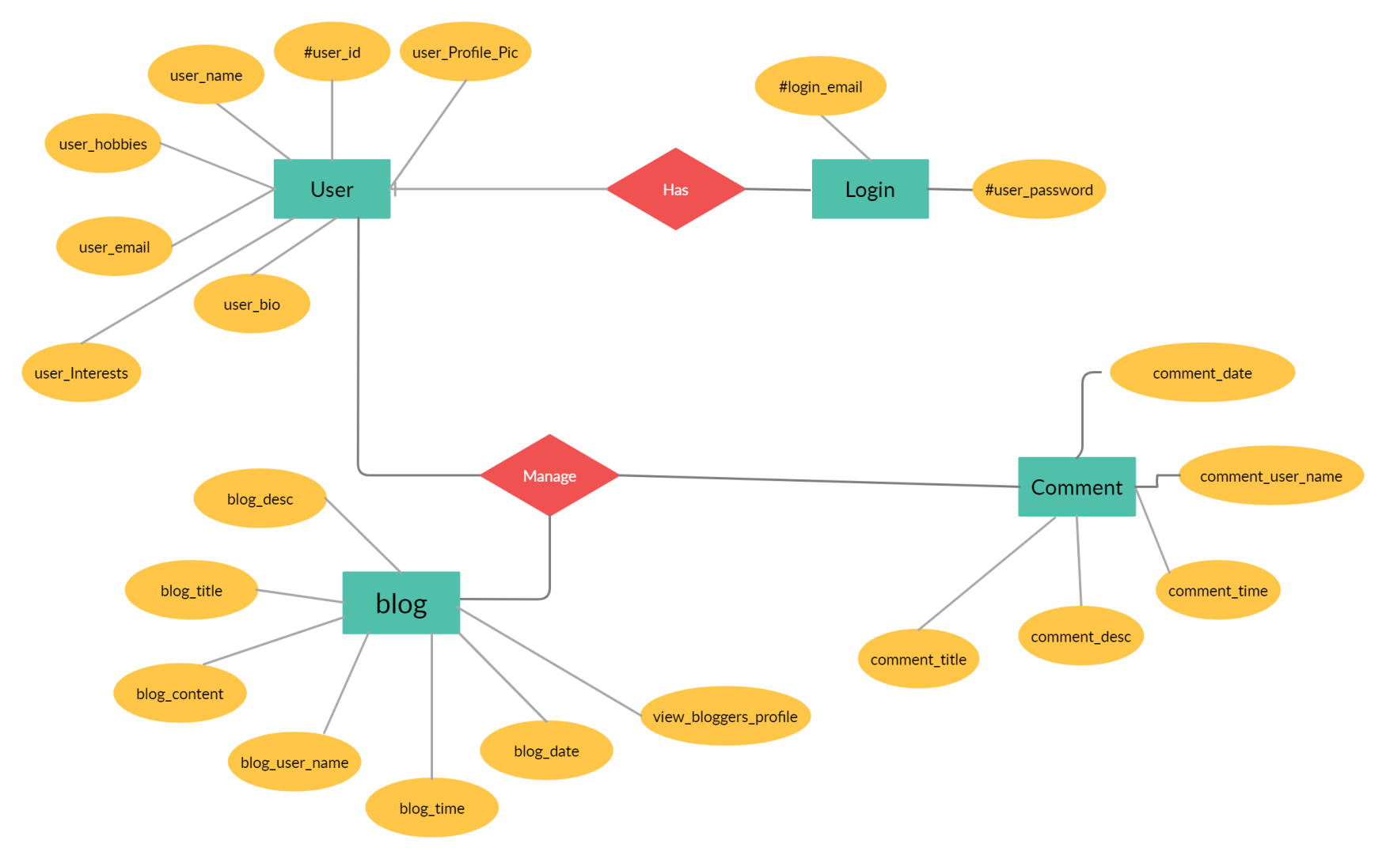
Data Model

Slide 8
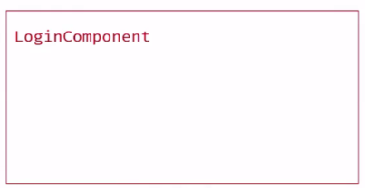
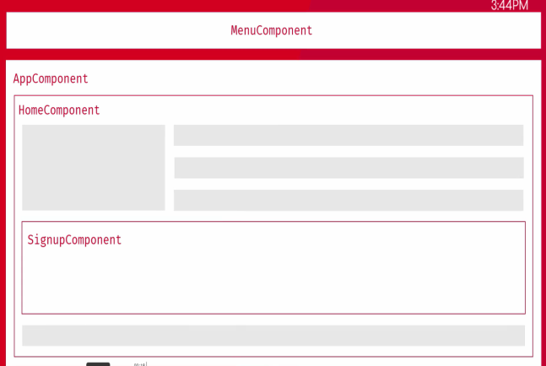
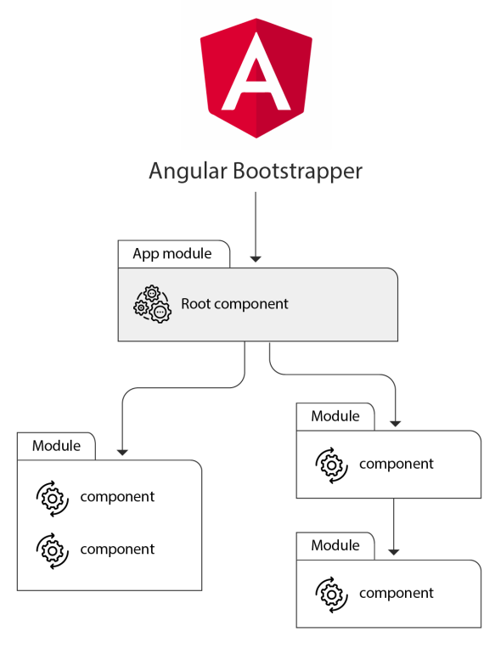
Building up the Final App
1. Using Angular Components
Login Component
App Component
My Blogs Component
Edit-Profile Component
Create Post Component
Post Component
View Post Component
Profile Component
Comments Component

Slide 9

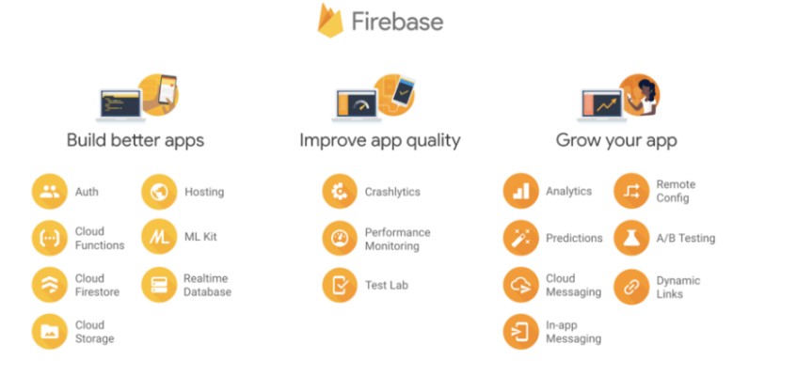
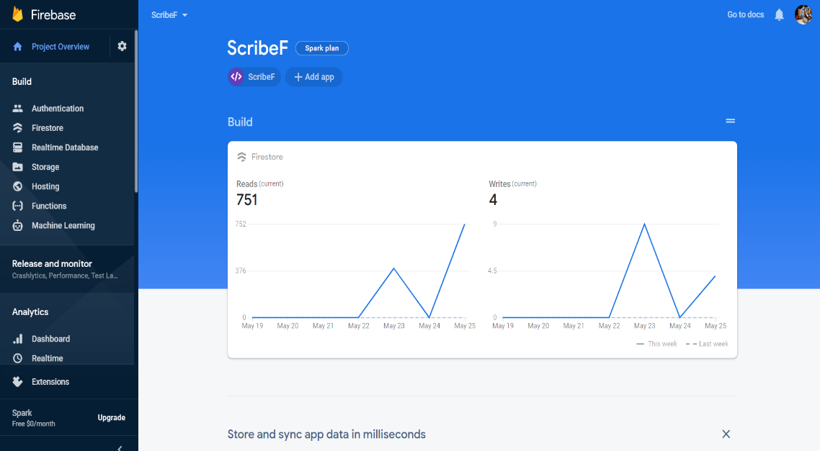
Using
Incredibly Built-In Analytics
App Development made easy
Growth and User Engagement
Increase Your Earnings

Slide 10
FEASIBILITY STUDY
Feasibility Study
System: SCRIBE- BLOGGERS SOCIAL MEDIA
Product
The project requires a web application to be developed that will acts as a Social Media for BLOGGING/BLOGGERS.
Technical Feasibility
The web application will be developed using Html, Css, Bootstrap, Angular, NodeJs and Firebase. The team is competent in that.
Social Feasibility
No training Required for Users, it’s like other social media app- Facebook, Instagram etc. Some trainings for the admin is required.
Market Research
Market research says that this application would be useful for the users to share their thoughts and craziest ideas with the World. We also give payments to professional Bloggers for blogging in our site.
Economic Feasibility
The application can be developed within budget.

Slide 11
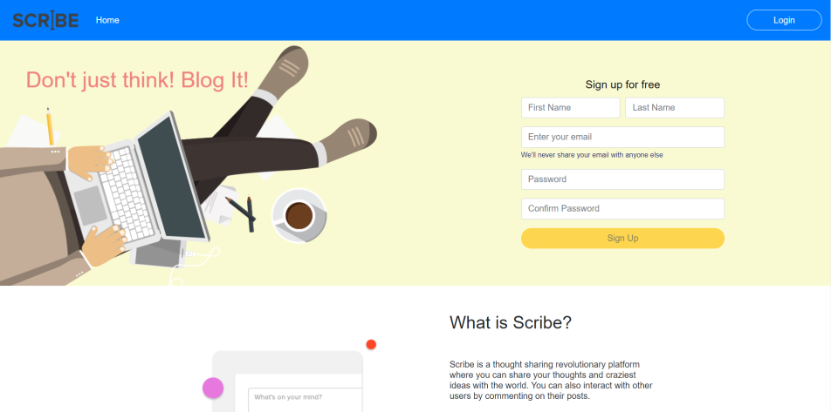
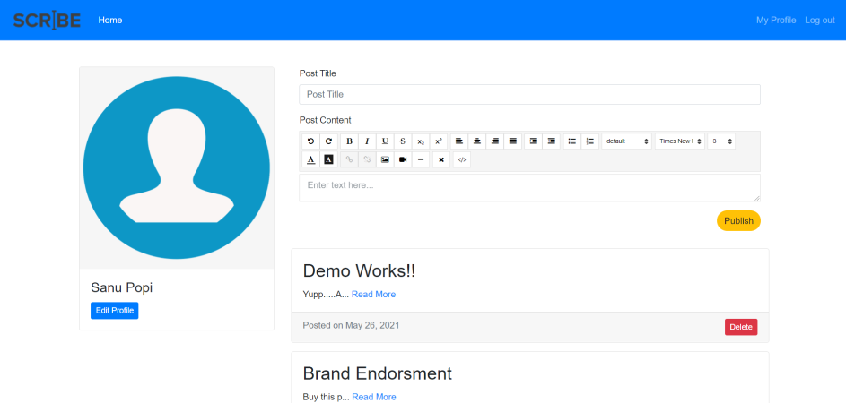
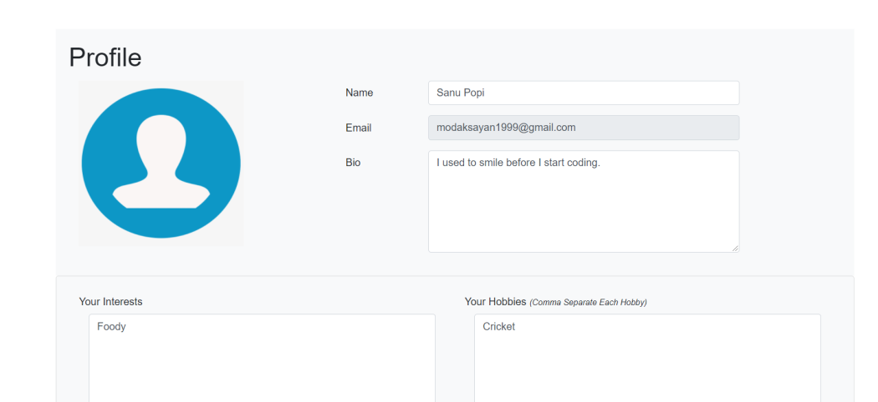
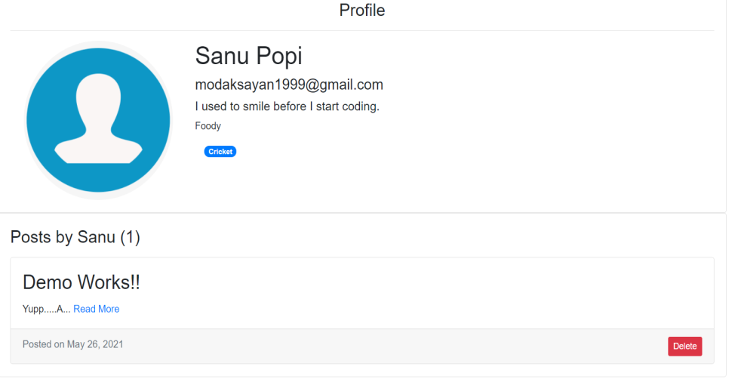
Working APP Beta Version

Slide 12

FUTURE SCOPE
ADD GOOGLE AD-SENSE
BRAND-PROMOTING
A BIG EMPLOYEMENT OPPORTUNITY
ADD V-LOG POST OPTIONS

Slide 13

THANK YOU FOR STAYING WITH US

